Slide 1
KC
4 DOF ROBOT ARM
D.M.S.P. Dissanayaka - 210141U
P.N. Kulasingham - 210303U
M.P.D.N. Wickramasingha - 210705E

Slide 2
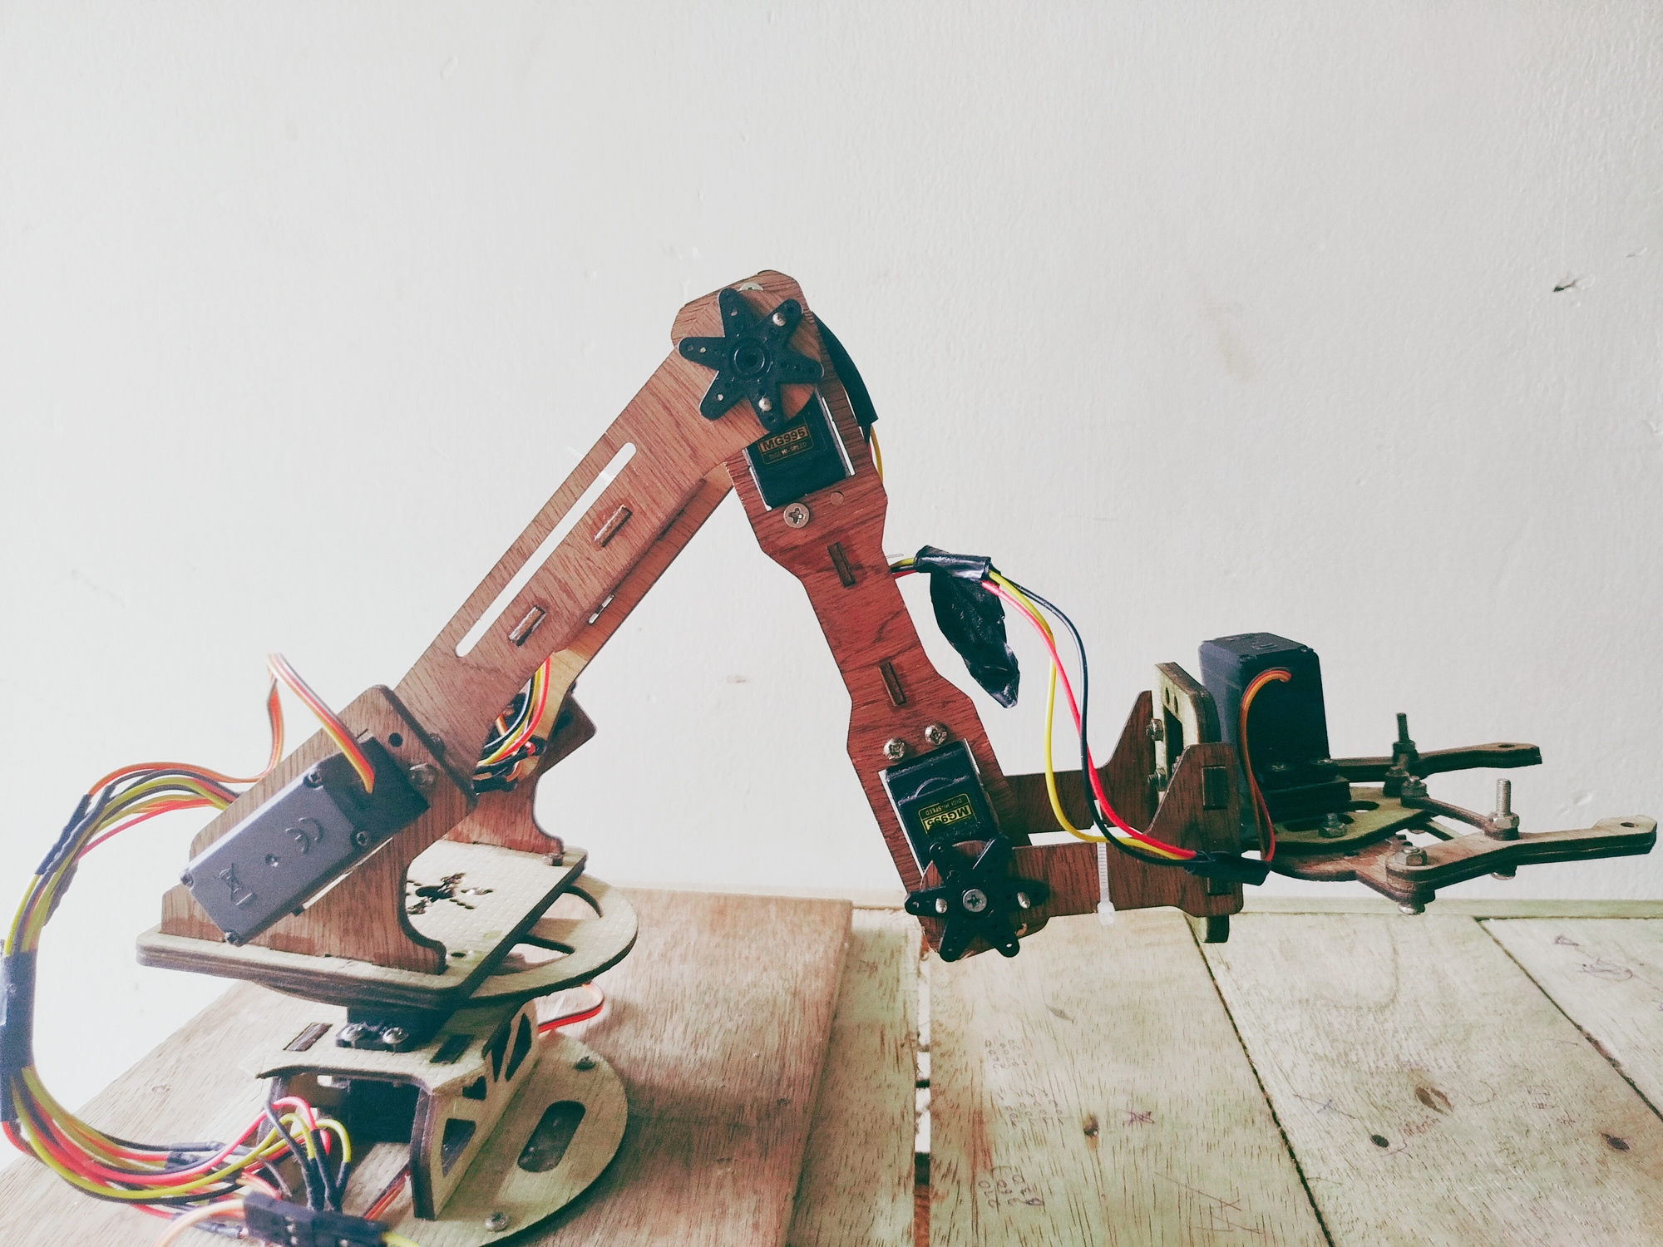

Slide 3
IMPLEMENTATION
MATLAB
ARDUINO
Calculate forward or inverse kinematics
Input angle to servo motors

Slide 4
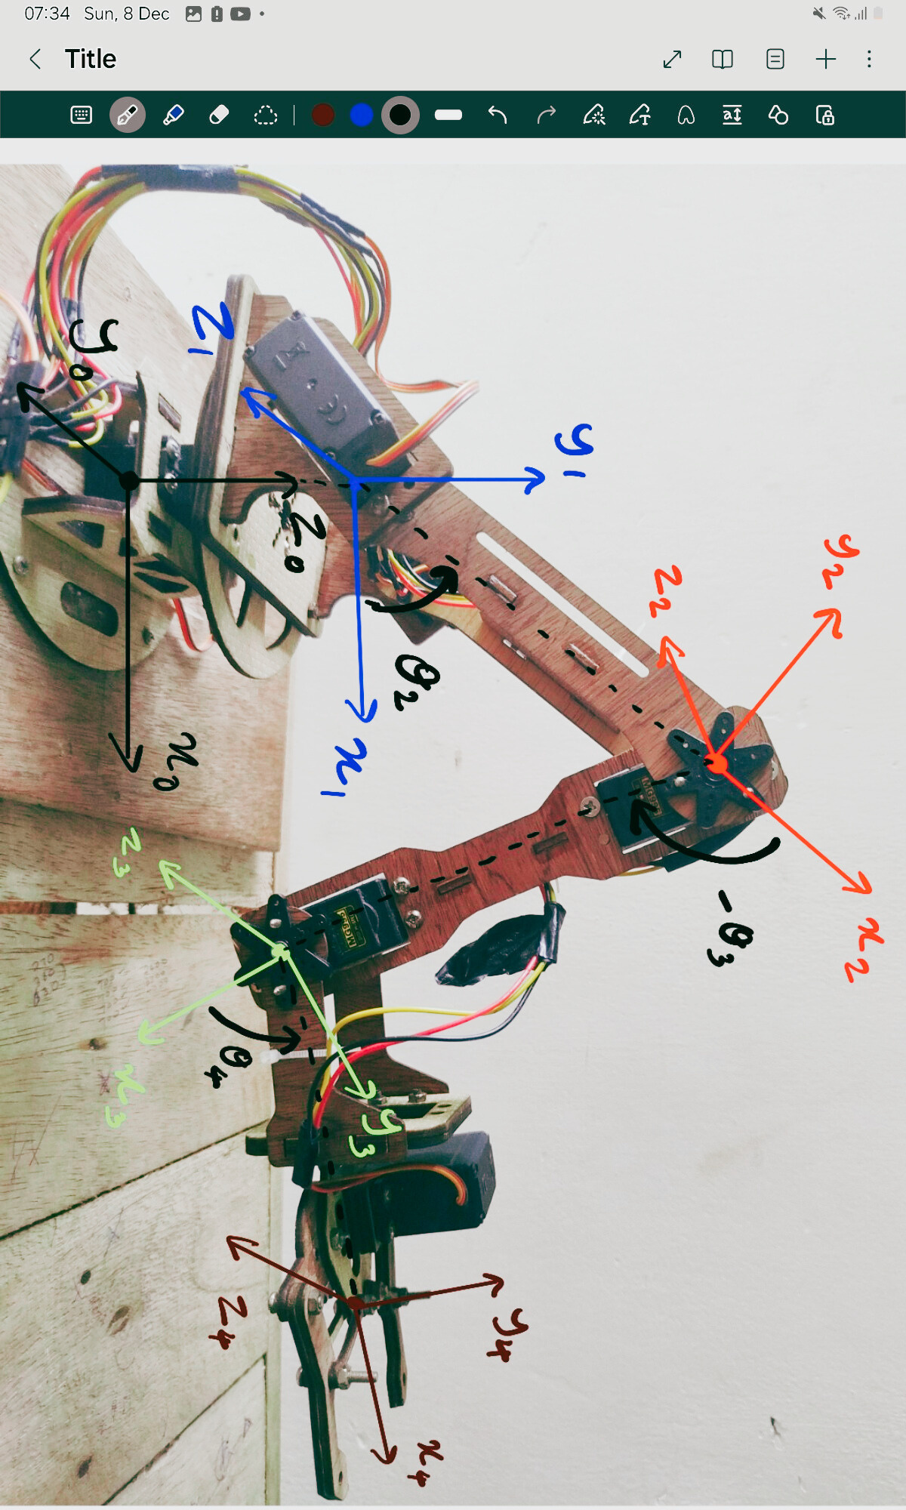

Slide 5
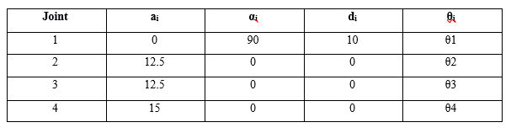
DH TABLE

Slide 6
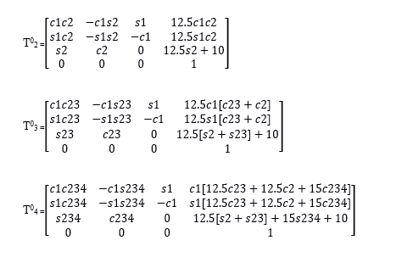
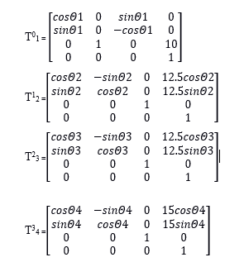
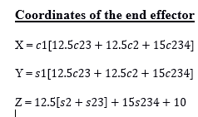
Forward Kinematics

Slide 7
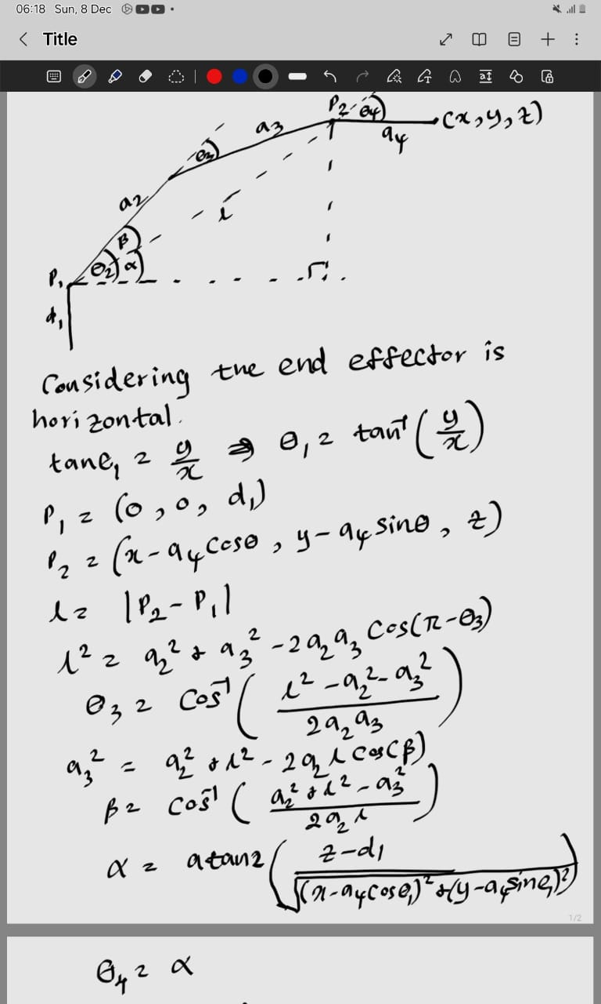
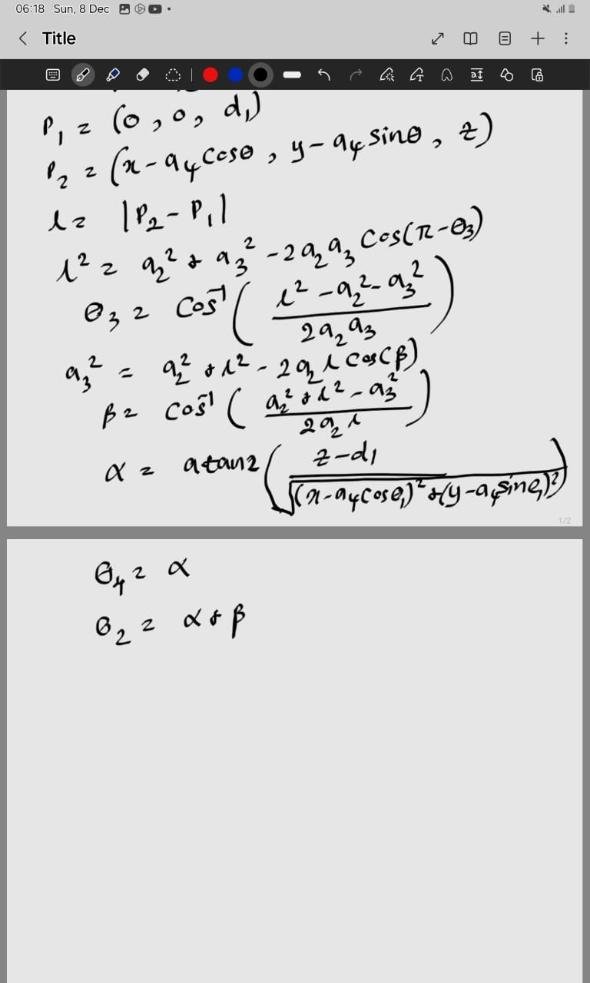
Inverse Kinematics

Slide 8
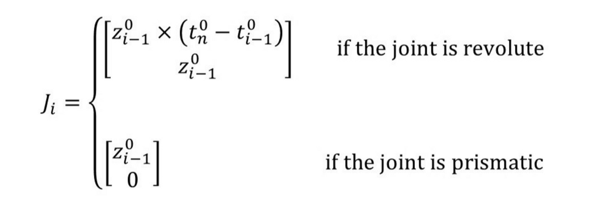
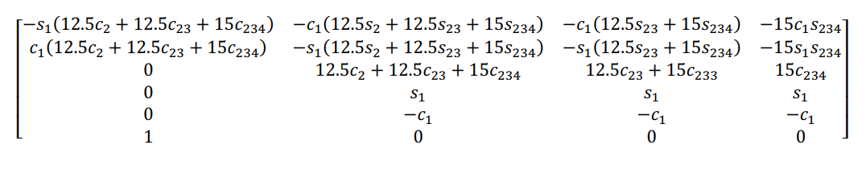
JACOBIAN

Slide 9
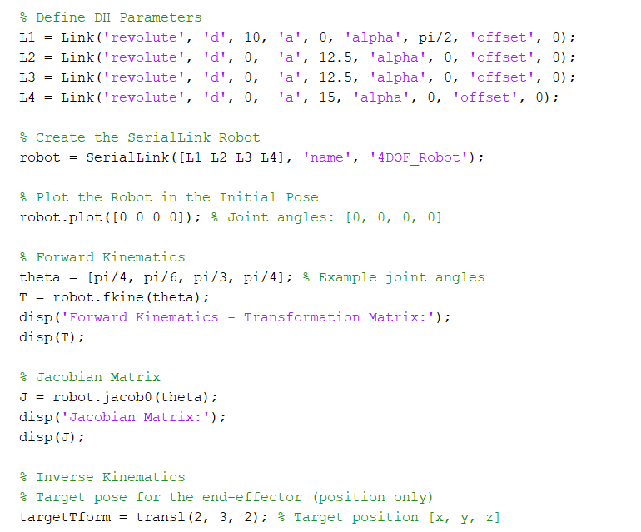
MATLAB CODE
Forward Kinematics

Slide 10
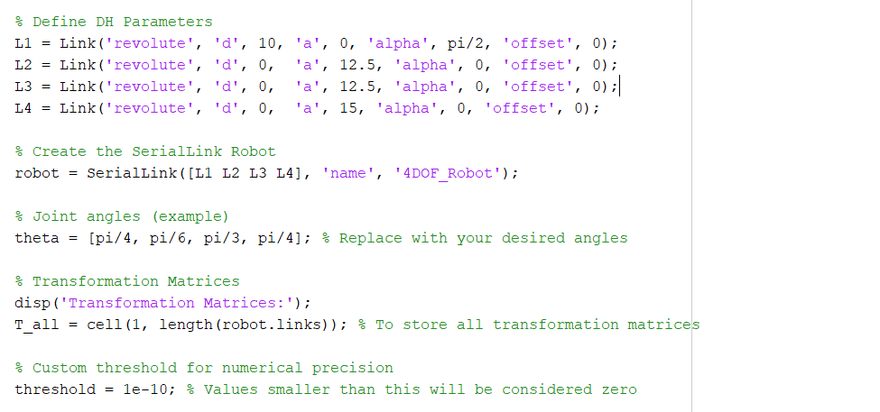
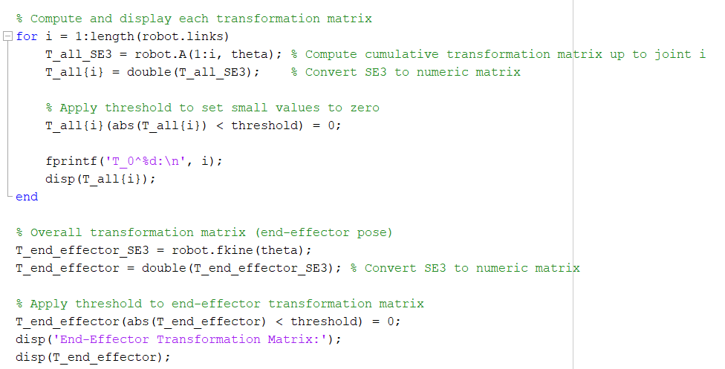
MATLAB CODE
Transformation Matrices

Slide 11
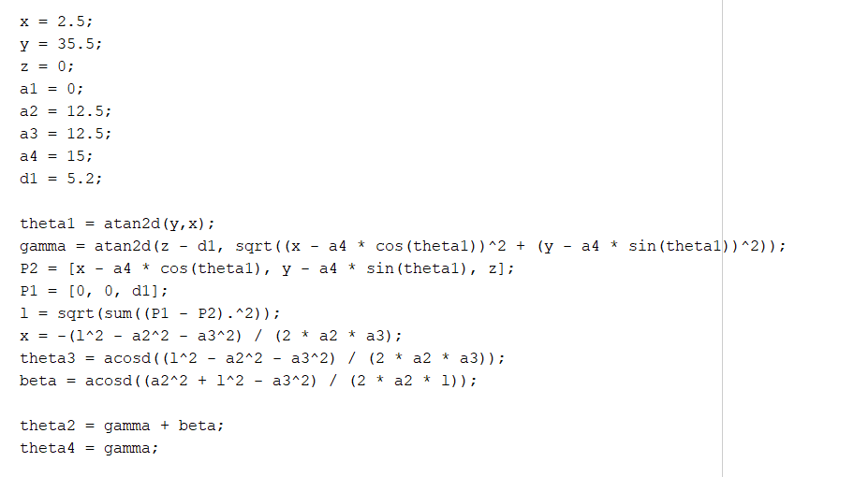
MATLAB CODE
Inverse Kinematics

Slide 12
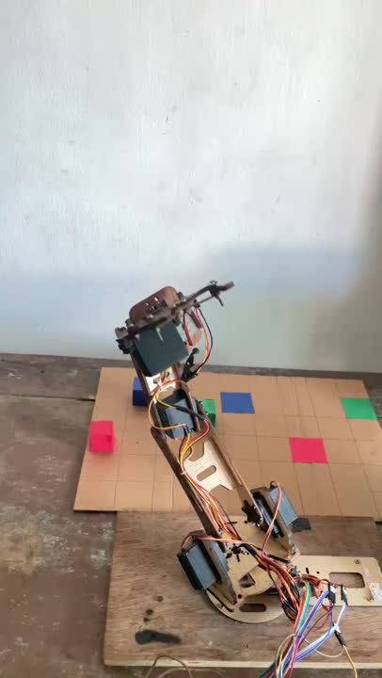

Slide 13
Thank You!

